Slide 1
ML driven high-pressure Li-Cu-H Ternary Hydrides discovery

Slide 2
NOTE
The study and results presented here represent an initial exploratory investigation.
While the predictions are grounded in well-established theoretical principles and robust machine-learning models, further detailed analysis—including literature review, additional calculations, and deeper physical interpretation—remains to be carried out.

Slide 3
Workflow
Generated ~2,000 Li–Cu–H structures using MatterGen, each with lattice constants and atomic coordinates (POSCAR format).
Used MatterSim + MLIP (trained on >5M structures) to fully relax all candidates under pressures from 0 to 100 GPa.
Collected stress, energy, enthalpy, and other properties from the relaxed structures.
Ran DFT calculations for pure Li, Cu, and H reference phases to obtain their accurate energetic baselines at the same pressures.
Evaluated formation enthalpy for every Li–Cu–H compound using the appropriate elemental and molecular reference states.

Slide 4
Workflow
ML-predicted stable Li–Cu–H phases → re-optimized using full DFT relaxation
Post-relaxation SCF step yields accurate energies & enthalpies
Formation enthalpy recomputed using identical reference scheme
DFT convex hull built at each pressure
ML vs. DFT stability compared for consistency and validation

Slide 5
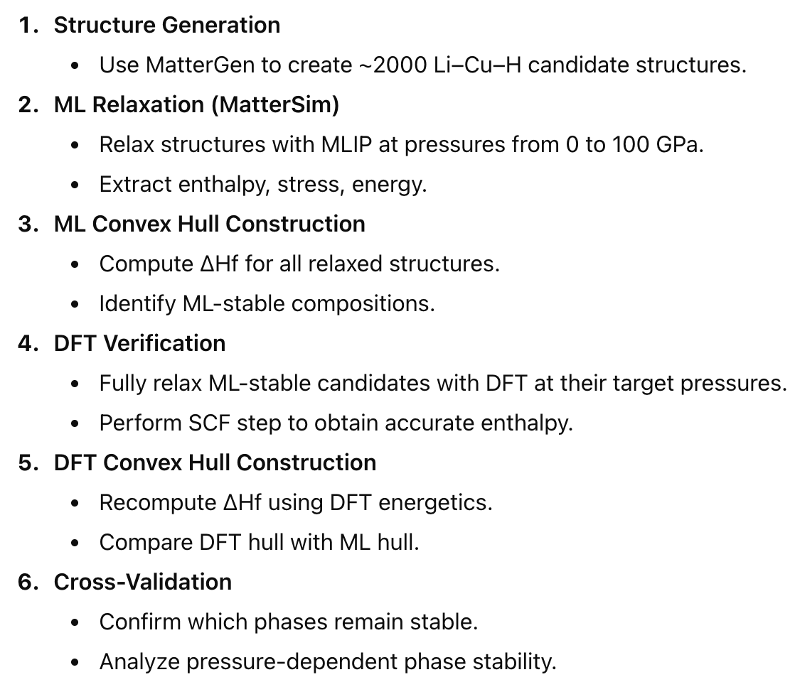
Overall Workflow

Slide 6
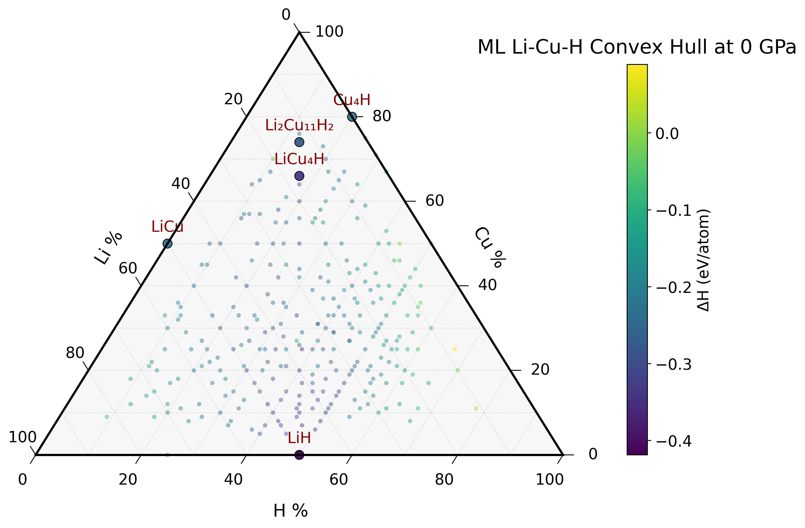
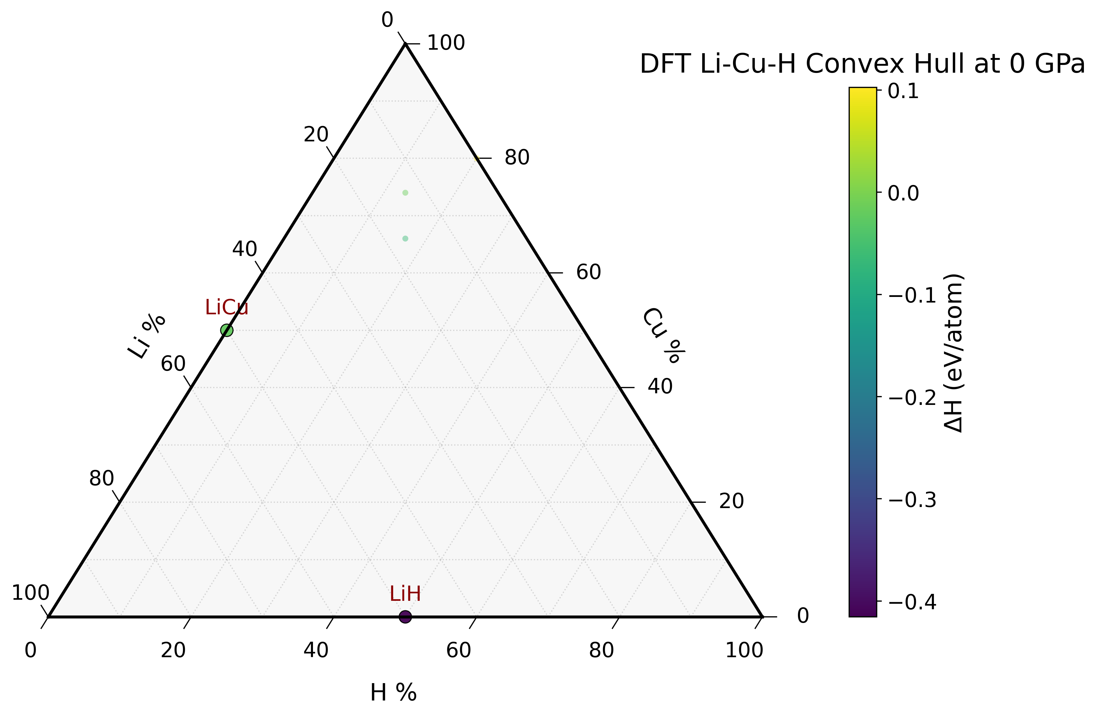
Results

Slide 7
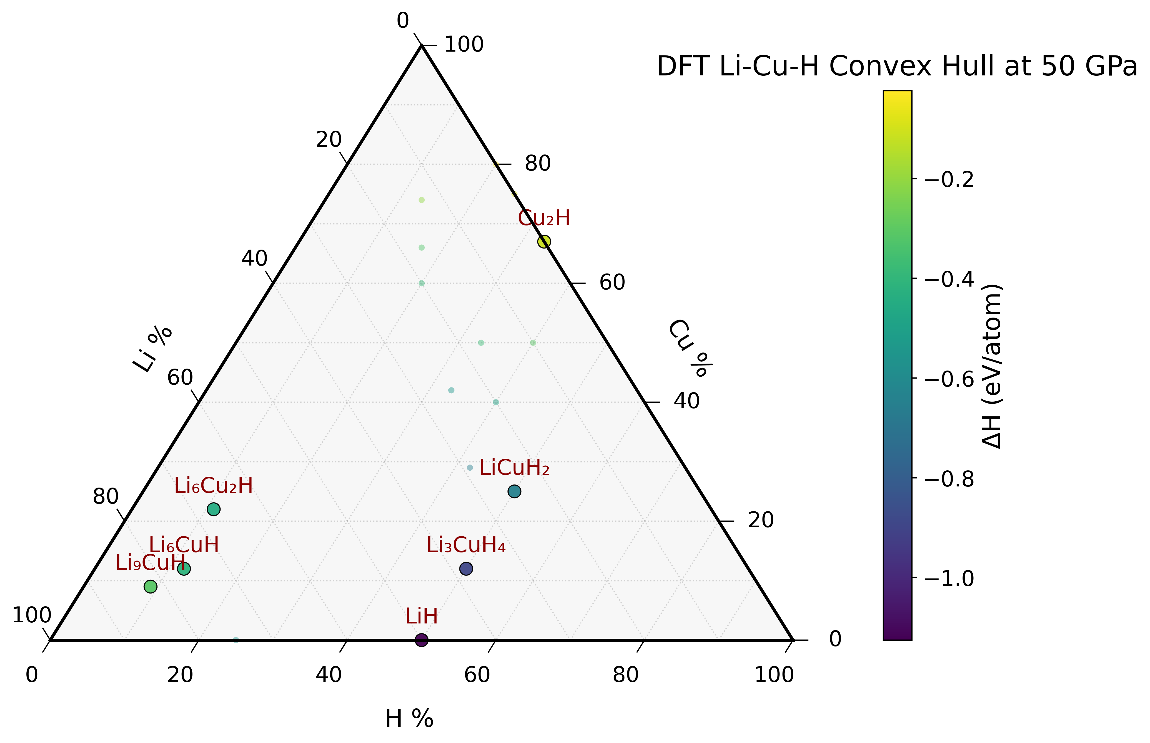
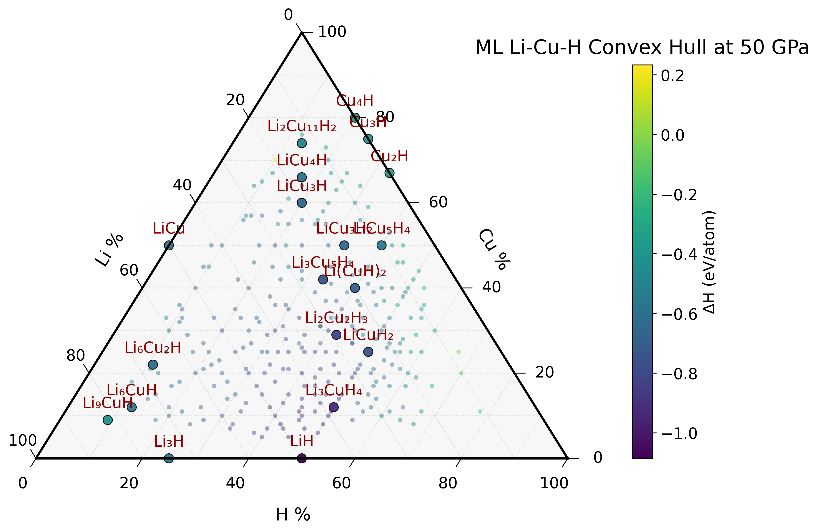

Slide 8
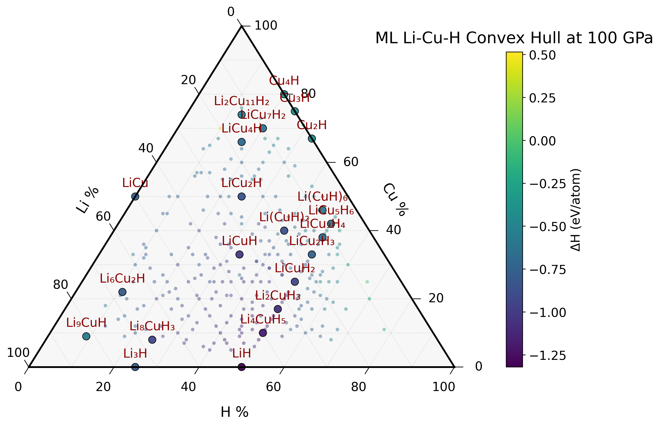
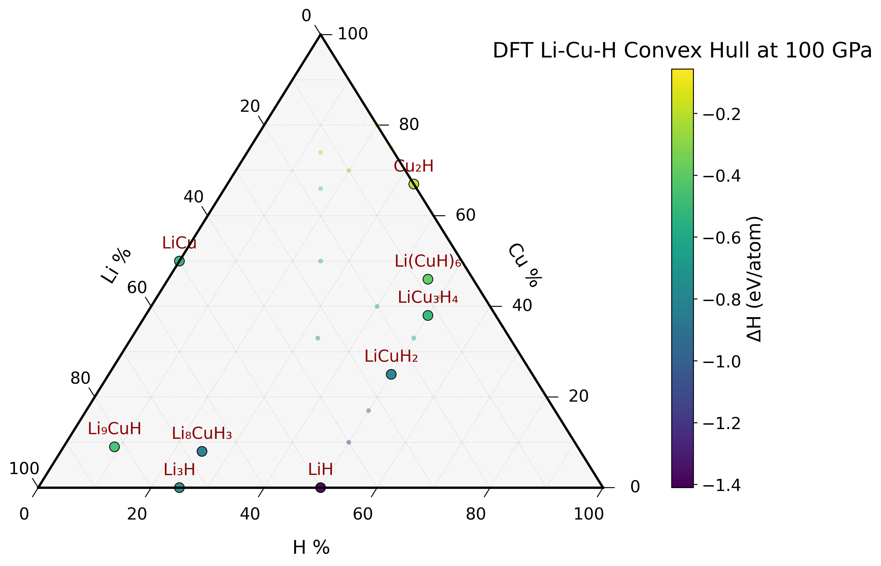

Slide 9
Key findings
At ambient conditions, Only the binary compounds LiCu and LiH are stable. Li-Cu-H ternary compounds are not fully stable at this condition.
As the pressure increases (e.g. at/above 50 GPa here), the Li-Cu-H ternary compositions become energetically more favorable.

